Slide 1
Unit: How do plants drink?
M.1
Topic: Water Transportation in Plants

Slide 2
A C T I V I T I E S
Video
Vocabulary
Structure
Experiment
Science Show

Slide 3
Colored Flowers

Slide 4
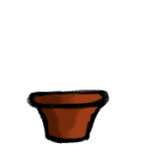
Colored Flowers
1. What do we need for this experiment?
2. How long do the flowers take to change their colors?

Slide 5
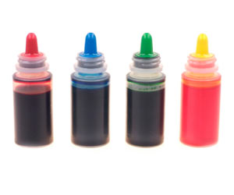
food coloring (n.)
a digestible substance used to give color to food; "food color made from vegetable dyes"
Mix some food coloring and water in a glass.

Slide 6
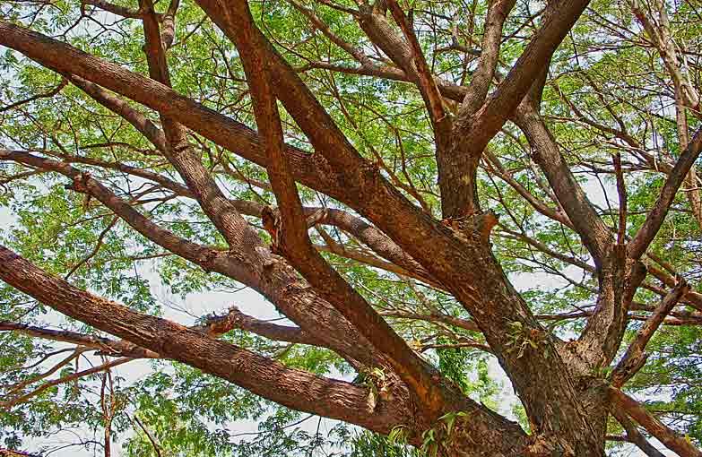
stem (n.)
There are a lot of leaves on the stems of plants.
the long, thin part of a plant that the leaves and flowers grow on

Slide 7
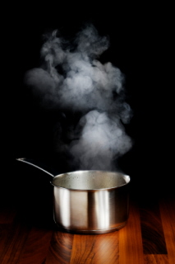
evaporate (v.)
to cause a liquid to change to a gas especially by heating
If a liquid evaporates, it changes into vapour.

Slide 8
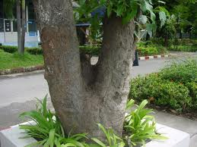
stalk (n.)
The stalk of a plant transports water from underground water.
the main stem of a plant, or the narrow stem that joins leaves, flowers or fruits to the main stem of a plant

Slide 9
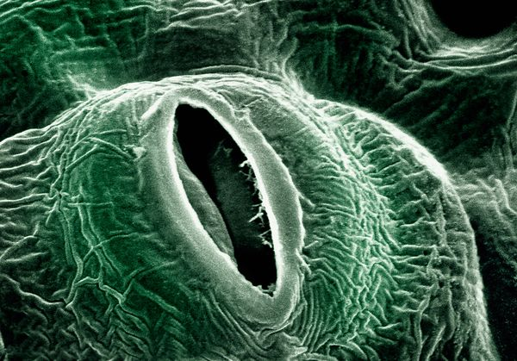
stomata (n.)
The water is evaporated from the leaves through the stomata.
one of the minute pores in the epidermis of a leaf or stem through which gases and water vapor pass

Slide 10
Imperative Sentence
Use the infinitive to form the imperative.
Put “Don’t” before an infinitive to form a negative sentence.
Don’t
Infinitive
infinitive
complement
complement
Don’t come here.
Come here.
Don’t clean a classroom.
Clean a classroom.
Don’t help your father.
Help your father.
Don’t dip a flower in colored water.
Dip a flower in colored water.

Slide 11
Imperative Sentence
Another form of imperative is using “Let’s” before an infinitive to be an invitation.
Let’s
infinitive
complement
Let’s go to school.
Let’s begin the experiment.
Let’s help our mother cook dinner.
Let’s ride a bike to a supermarket.

Slide 12
Plant Transportation Experiment
Experiment
Observation
Experimental
Equipment
Plant Transportation Experiment

Slide 13
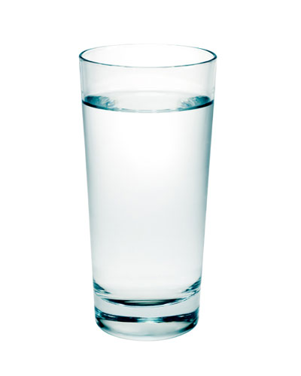
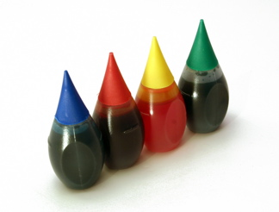
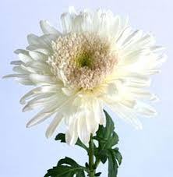
Experimental Equipment
Directions:
Make a group of three by counting 1 to 11.
2. Walk to your own group.
3. Listen to the sound and do what you hear.
a glass of water
food coloring
white Florist’s Mun

Slide 14
Plant Transportation Experiment
Take a glass of water.
Add some food coloring
into a glass of water.
Mix it completely.
Dip a white flower into a glass of colored water.

Slide 15
Science Show
Directions:
Stay with your own group and finish your observation worksheet.
Take ten minutes to create your own talented science show about transportation experiment.
Prepare your dialogues and necessary stuffs of a show.
In the show, tell your friends the steps and the outcome of the experiment. Try to make it interesting.

