Slide 1
Unit: travel around the world
Topic: weather
Matthayomsuksa 1

Slide 2
Conversation
Activity 1
Video Song
Activity 2
Vocabulary
Structure

Slide 3
What is the weather like today?

Slide 4
1. How many kinds of weather are there in the video?
2. What do you do in a sunny day?

Slide 5
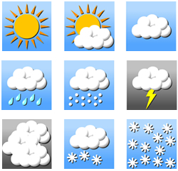
(n.) the condition in the air above the earth such as wind, rain, temperature, especially at a particular time over a particular area
weather
The weather today is very sunny.

Slide 6
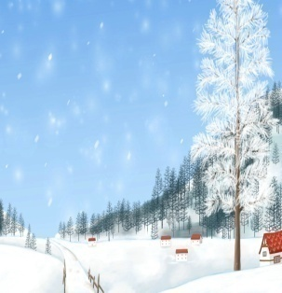
(n.) the season between autumn and spring, lasting from November to March
winter
It always snows in winter.

Slide 7
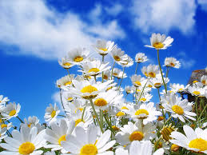
(n.) the season of the year between winter and summer, lasting from March to June
spring
Many flowers bloom in spring.

Slide 8
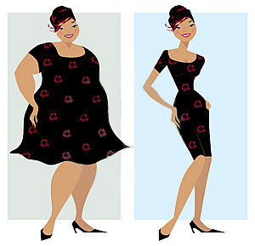
(v.) to exchange one thing for another thing
change
She changes herself a lot.

Slide 9
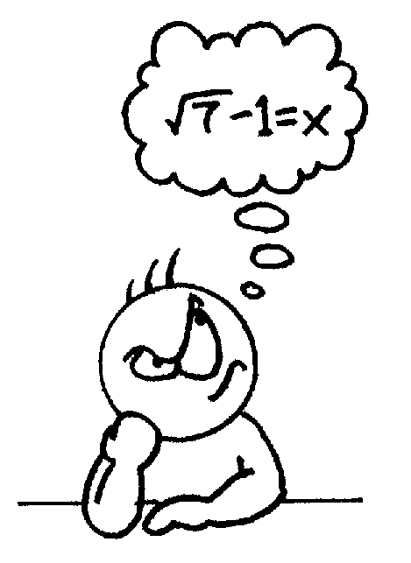
(v.) to believe something or have an opinion or idea
think
Ken thinks about the solution.

Slide 10
Present Simple Tense
Form:
S
V1
O
add –s/ -es
Usage:
It changes a lot.
1. To express the general truths
It snows so much.
2. To express the habitual actions
He eats ice cream .

Slide 11
How to add an s or an es after verbs
1. Add an s after general verbs.
work
works
change
changes
2. Change ‘y’ for “i” and add an es.
cry
cries
try
tries
3. Add an es after verbs with s, ss, ch, sh, o.
go
goes
finish
finishes

Slide 12
Jesse: What’s the weather like in Washington D.C.? k Matt: It changes a lot! I think the best time is spring. That’s when the cherry trees are in bloom. k Jesse: What about fall? k Matt: Fall is a nice time of year, too. The best thing about it is that all trees change color. The leaves turn red, orange, and yellow.

Slide 13
Jesse: What’s summer like? k Matt: The worst thing about summer is that it’s really hot and humid. The best thing about summer is eating lots of ice cream! k Jesse: And winter? k Matt: Winter is freezing cold! That’s the worst thing about it. But the best thing is that sometimes it snows so much that we can’t go to school! k Jesse: Wow!

Slide 14
1. What is the worst thing about summer in Washington D.C.?
It is really hot and humid.
2. What is the best thing about winter in Washington D.C.?
It snows so much so we can’t go to school.
3. What is the best thing about fall?
All trees change color. The leaves turn red, orange and yellow.

Slide 15
ACTIVITY 1 Rearranging Letters Game
1. Find your partner.
2. Have a look at the letters given on the screen.
3. Take ten seconds to form a correct word with your
partner.
4. Raise your hand if you are ready to answer by spelling
the correct word.
5. Any teams that answer correctly will get one point.

Slide 16
Direction: Rearrange the letters given to form a correct word.
T
N
R
I
W
E
W
I
N
T
E
R

Slide 17
Direction: Rearrange the letters given to form a correct word.
R
E
W
A
H
T
E
W
E
A
T
H
E
R

Slide 18
Direction: Rearrange the letters given to form a correct word.
N
K
I
H
T
T
H
I
N
K

Slide 19
Direction: Rearrange the letters given to form a correct word.
G
H
C
N
A
E
C
H
A
N
G
E

Slide 20
Direction: Rearrange the letters given to form a correct word.
R
N
I
S
P
G
S
P
R
I
N
G

Slide 21
ACTIVITY 2 Writing Postcard
1. Take one piece of paper.
2. Write a postcard about your favorite weather,
the best and the worst things of that weather.
3. Color your piece of paper.
4. Present your work at the front of the class.

Slide 22
Direction: Write a postcard about your favorite weather, the best and the worst things to do, draw a picture and then present to class.

Slide 23
Group Members 1. Ms. Jariya Ruangrua 54010513007 2. Mr. Thitiphong Kon – ngam 54010513012 3. Mr. Nutthaphol Phudensai 54010513044 3rd year students of English Major Faculty of Education Mahasarakham University

