Slide 1
Unit: Fractions
Pratomsuksa 5
Topic: Adding and Subtracting Fractions

Slide 2
Video
Vocabulary
Structure
Fractions
Fraction Stripes
Word Problems
A C T I V I T I E S

Slide 3
Fractions

Slide 4
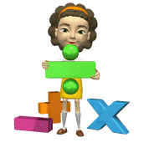
Fractions

Slide 5
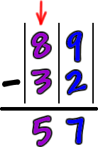
subtract (v)
Can you subtract six from ten?
to take the number or amount away from another number or amount

Slide 6
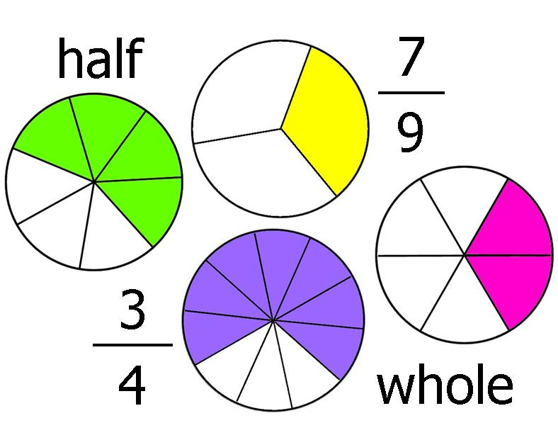
fraction (n)
We are studying fractions now.
a number less than one such as ½ or ¾

Slide 7
hexagon (n)
This box is in a shape of hexagon.
a flat shape with six sides of the same length

Slide 8
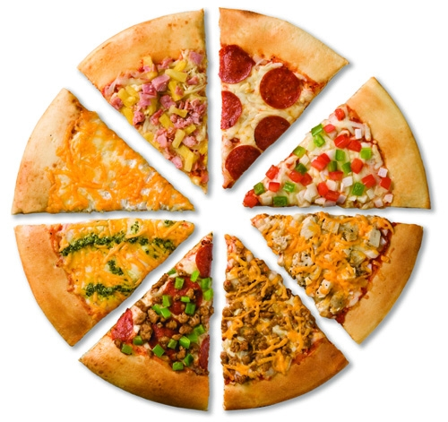
piece (n)
My sister ate two pieces of pizza.
an amount of something or a part of something

Slide 9
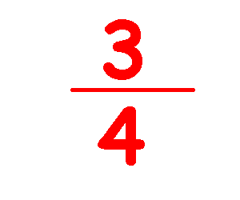
denominator (n)
Four is a denominator of ¾.
a number below a line of a fraction

Slide 10
There-be Sentences
Use there is for a singular noun and there are for a plural noun.
There is
Singular noun
There are
plural noun
There is an apple in a basket.
There is one piece of pizza left.
There are six pieces of a hexagon.
There are many pencils in a box.

Slide 11
There-be Sentences
Add a not after is or are to form a negative sentence for a there-be sentence
There is
not
Singular noun
There are
not
plural noun
There is an apple in a basket.
There is not an apple in a basket.
There is one piece of pizza left.
There is not one piece of pizza left.
There are not five pieces of a hexagon.
There are six pieces of a hexagon.
There are many pencils in a box.
There are not many pencils in a box.

Slide 12
There-be Sentences
Move is or are before there to form an interrogative sentence and put “?” at the end.
Is
there
Singular noun
?
Are
there
plural noun
?
Is there an apple in a basket?
There is an apple in a basket.
Is there one piece of pizza left?
There is one piece of pizza left.
Are there six pieces of a hexagon?
There are six pieces of a hexagon.
Are there many pencils in a box?
There are many pencils in a box.

Slide 13
Fractions
numerator
denominator
9
10
Each piece is of the hexagon.
=nine-tenths
is of the hexagon.
12
20
=twelve-twentieths

Slide 14
Adding fractions
3
8
7
8
4
8
4
6
5
6
1
6
When is added with , it becomes .
When is added with , it becomes .

Slide 15
Subtracting fractions
-
3
8
7
8
4
8
When is subtracted from , it becomes .

Slide 16
Fraction Stripes
Directions:
Make a group of three by counting 1 to eleven.
Take a piece of 16-parted folded paper and some pieces of colored paper
from a teacher.
Listen to the fractions what the teacher tells you, put some pieces of paper on the folded paper and find the correct answer.
The group that can answer first gets two points for each round.

Slide 17
Fraction Stripes
15
16
4
16
8
16
-
8
16
+
=?
=?
1
1
2
2
3
3
4
4
5
5
6
6
7
7
8
8
9
9
10
10
11
11
12
12
13
14
15
12
16
7
16
The answer is .
The answer is .

Slide 18
Fraction Stripes
1
8
2
8
1
4
8
16
7
8
11
12
3
4
3
4
7
16
5
8
9
12
1
4
-
-
+
+
+
-
=?
=?
=?
=?
=?
=?

Slide 19
Word Problems
Directions:
Make a group of three by finding the same fractions.
Walk into and bring a piece of paper back to your own group.
Read the two questions and find the solutions or the answers.
Present your steps of finding the solutions or the answers in front of class.

Slide 20
Word Problems
4
8
1
9
1.Lihua spent of her allowance on food
and shopping. What fraction of her allowance had she left?
2. The mass of box A is kilograms. The mass of box B is kilograms.
What is the total mass of 2 boxes?
How much heavier is box B than box A?
5
9

