Slide 1
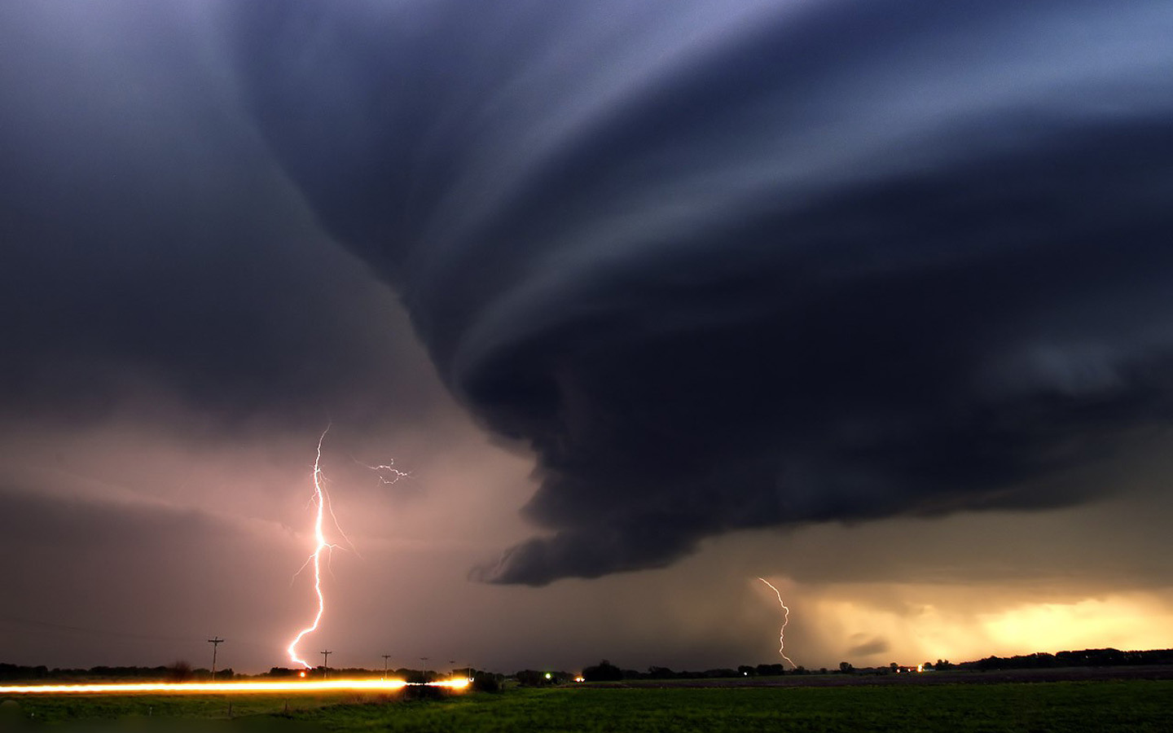
UNIT: MYSELF
TOPIC: PERSONAL EXPERIENCES
M.6

Slide 2
M.6
UNIT: MYSELF
TOPIC: PERSONAL EXPERIENCES
BREAKING-NEWS
ACTIVITIES
VOCABULARY
ACTIVITY 1
STRUCTURE
ACTIVITY 2
CONVERSATION
ACTIVITY 3

Slide 3


Slide 4

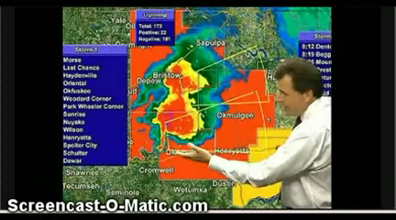

Slide 5
QUESTIONS
1. Where was the tornado outbreak reported in the breaking-news video?
2. How many strong tornadoes caused the damage in eastern rural areas?
3. Was there anyone killed in the tornado destruction?

Slide 7
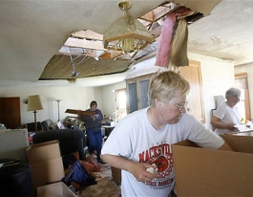
experience
(n.)
practical contact with and observation of facts or events
We had a terrible experience on tornado
last month.

Slide 8
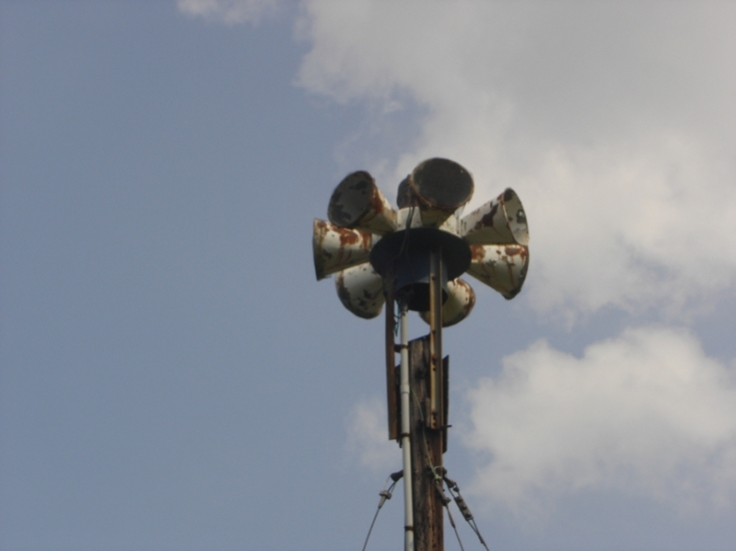

siren
(n.)
a device that makes a loud prolonged sound as a signal or warning
My mother and I were having dinner when the sirens went off.

Slide 9

rush
(v.)
to (cause to) go or do something very quickly: moving with urgent haste
When we were sure that was the tornado, we all rushed to the basement.

Slide 10
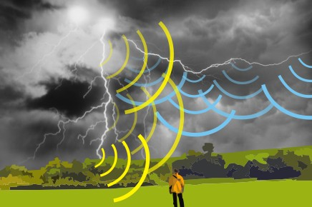

rumbling
(adj.)
making or constituting a deep resonant sound
In the basement, I heard the rumbling noise like the train.

Slide 11
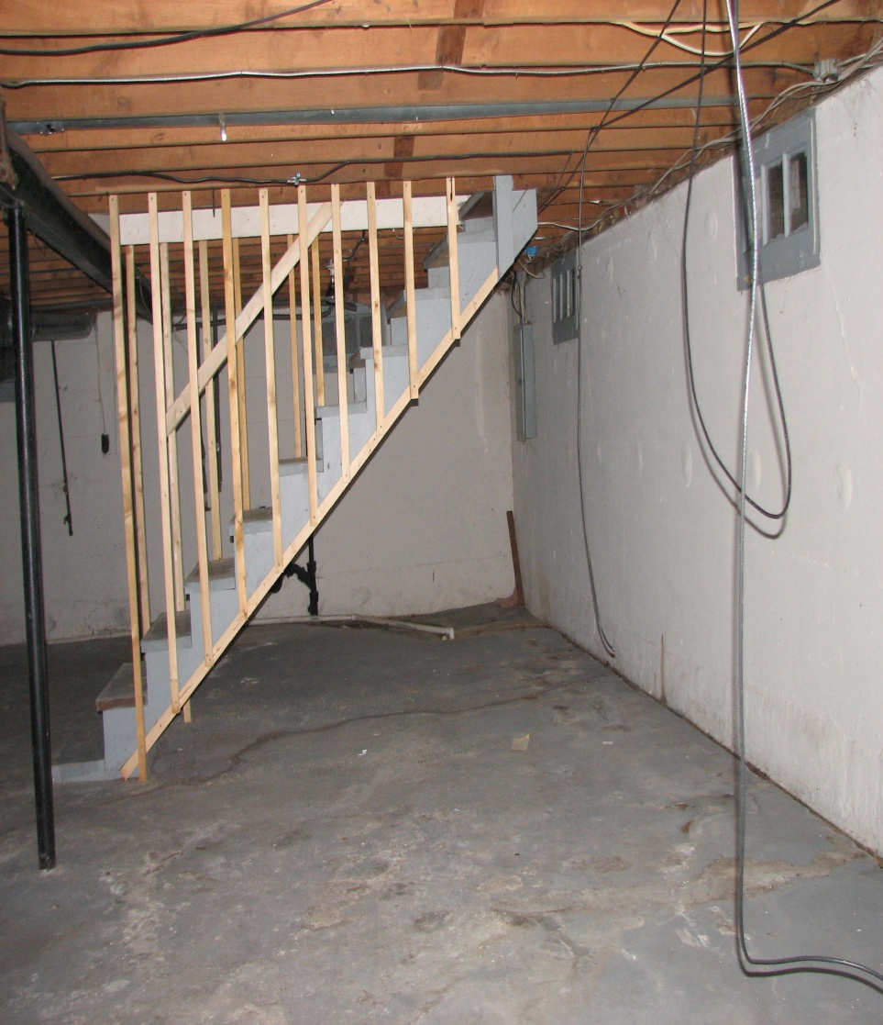
basement
(n.)
the floor of a building partly or entirely below ground level
Mary and her children were going to the basement when the tornado came.

Slide 12
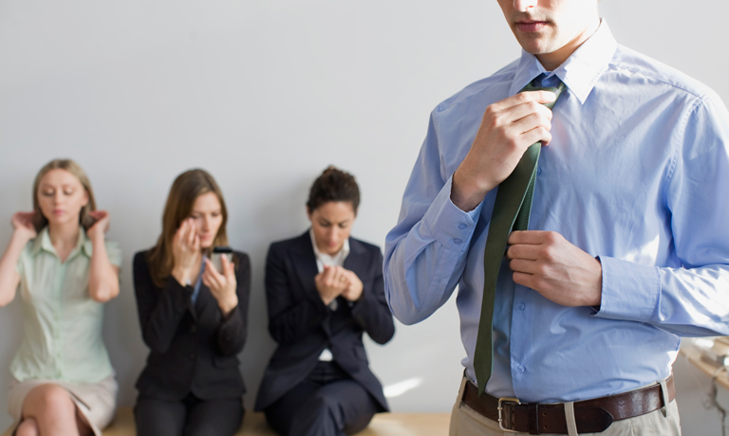
impression
(n.)
an idea, feeling, or opinion about something or someone, without conscious thought or on the basis of little evidence
I didn’t get much impression of the place because it was dark when I drove through it.

Slide 13
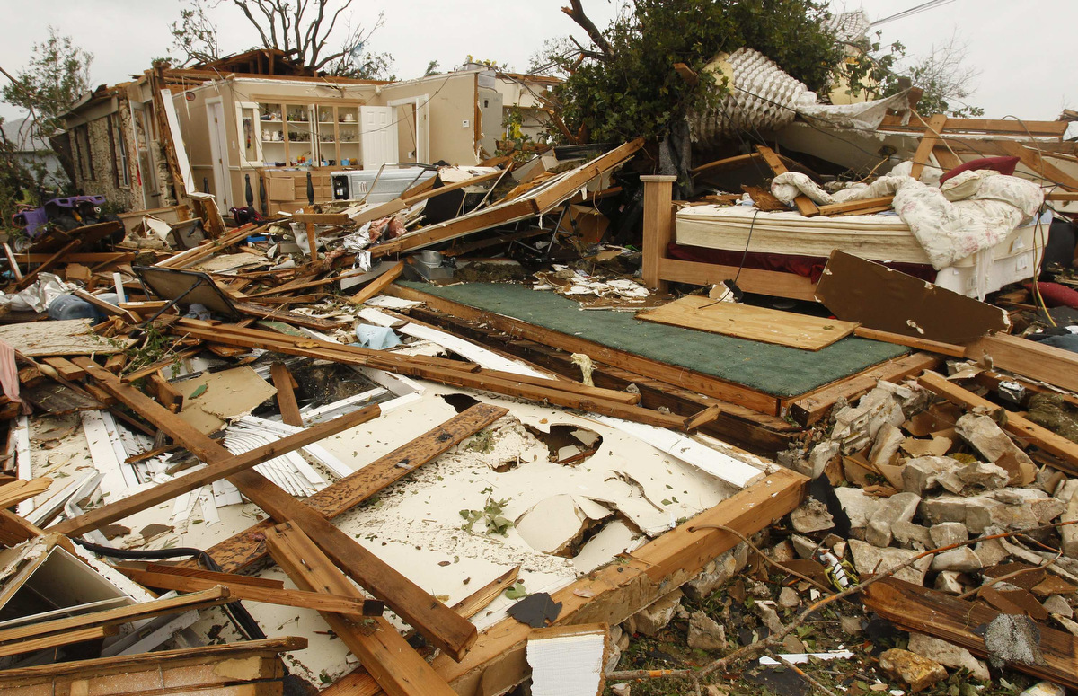
destruction
(n.)
the action or process of causing so much damage to something that it no longer exists or cannot be repaired
A few people in the town were injured by the destruction of tornado last month.

Slide 14
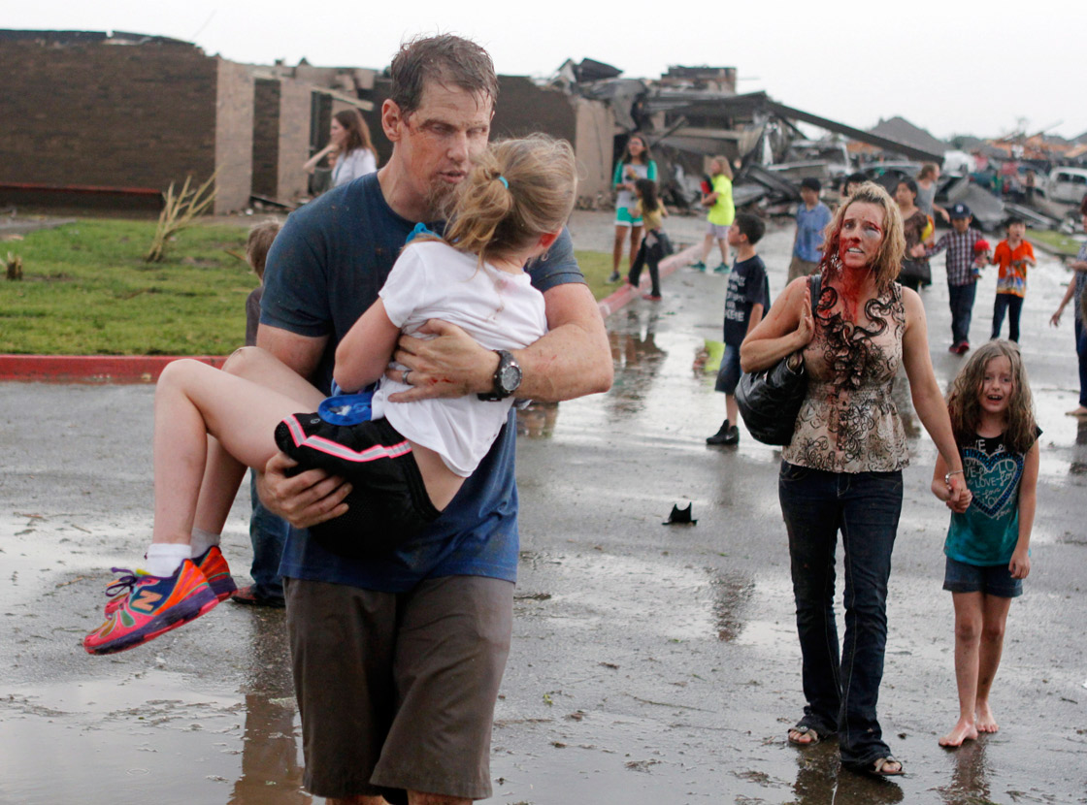
injure
(v.)
to suffer physical harm or damage to (a part of one's body)
We all were injured from the tornado destruction and our house was also flattened.

Slide 15
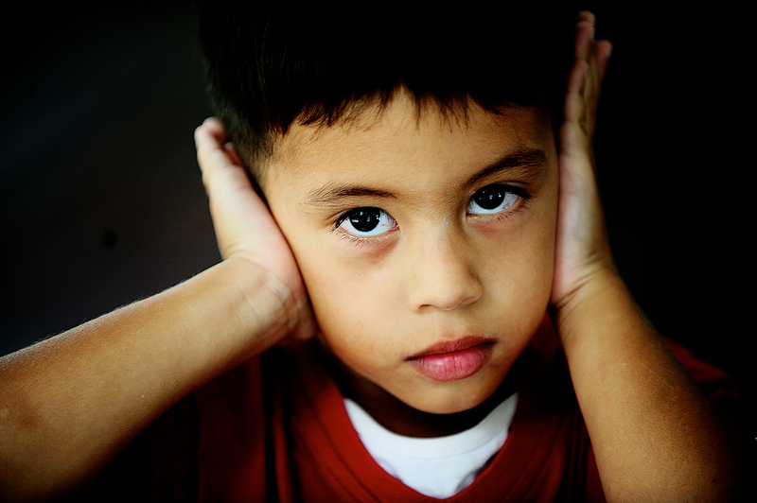
cover
(v.)
to put something such as a cloth or lid on top of or in front of (something) in order to protect or conceal it
My sister and I got really scared. We covered our heads with a cushion.

Slide 16
PAST CONTINUOUS TENSE
Forms:
S
was
Ving
were
At six o'clock last night, we were having dinner.
My mother, my sister and I were sitting at the table eating breakfast when we heard the sirens going off.
I was watching TV when she phone me.

Slide 17
PAST CONTINUOUS TENSE
Uses:
We use the form of Past Continuous to indicate the actions happening at the specific time in the past.
Use 1: An Interrupting Action
Past
Present
Future
You were not listening to me when I told you to turn the oven off.
While John was sleeping last night, someone stole his car.
Sammy was waiting for us when we got off the plane.
The happening action is meant to use the form of Past Continuous: was/were + Ving
The interruption action is differently meant to use the form of Past Simple: Past Verb

Slide 18
PAST CONTINUOUS TENSE
Uses:
We use the form of Past Continuous to indicate the actions happening at the specific time in the past.
Use 2: Two Happening Actions
Past
Present
Future
While Ellen was reading, Tim was watching television.
I wasn't paying attention while I was writing the letter, so I made several mistakes.
Were you listening while he was talking?
The happening actions are meant to use the same form of Past Continuous:
was/were + Ving to indicate the two or more specific actions.

Slide 19
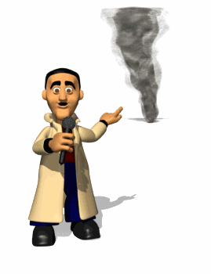
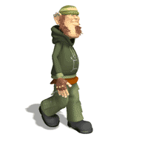

CONVERSATION
Click for overall conversation!
Jerry, would you tell us about your experience in the tornado?
My mom, my sister and I were all sitting at the table eating breakfast when we heard sirens going off. Out one window, the sky was totally clear. But in the other direction, the sky was really black.

Slide 20
Do you think it was just another storm?
Oh, we guessed it was a tornado, and we all rushed to the basement. Suddenly the electricity went out, and we got really scared. I covered my head with a cushion, but I could still hear this rumbling noise like a train. It got louder and louder.
How long did it last?
A few minutes, but it seemed like hours. Then all of a sudden it stopped. The tornado had passed by. We went upstairs and tried to open the door to the kitchen, but it was stuck. The ceiling had fallen in. So we got out through a window.

Slide 21
Can you describe what you saw when you went out of you house?
Most of the houses on our street were blown away -- there were just cement slabs left. People were coming out from their basements. In spite of all the destruction, it's amazing that only a few people in our town were injured.
What made the biggest impression on you?
Well, I remember seeing a car up in a tree. But the strangest thing was that a week later I was in a park and found a half-broken video game with my name written on it. The tornado had carried it across town!

Slide 22
COMMUNICATIVE STRATEGIES
Circum locution
Mime
Apply these to all speaking activities.

Slide 23
While-Speaking Activity 1
WHO TOOK MY LITTLE CAT?
Directions
1. Make a group of six students by counting 1 to 5 and go to your group to make a circle.
2. Take one piece of paper for each. The cat-picture is for a student who will say “Yes, I took you little cat.” for this round.
3. One volunteer from each group stands up to answer the teacher’s questions and to start the conversation drill.
4. The students taking the little cats from the tornado come to describe what you were doing when the tornado came to town.

Slide 24
While-Speaking Activity 1
WHO TOOK MY LITTLE CAT?
Conversation Guideline
Teacher: What were you doing when the tornado came to town? ...
Did you take my little cat?
Student A: I ..................... when the tornado came to the town. No, I ......(took)........ her little cat. What were you doing when the tornado came to town? Did you take my little cat?
Student B: I ..................... when the tornado came to the town. No, I ..................... your little cat. What were you doing when the tornado came to town? Did you take my little cat?
Student C: I ..................... when the tornado came to the town. Yes, I ..................... your little cat. What were you doing when the tornado came to town? Did you take my little cat?

Slide 25
While-Speaking Activity 2
SURVIVAL DISCUSSION
Directions
1. Make a group of five students by counting 1 to 6 and then walk to your own group.
2. Discuss in your own group about the experiences on tornadoes and the survival ways from that kind of disaster.
3. Each group takes a piece of paper and some pens to create the mind mapping of your group’s discussion about survival ways from tornadoes.
4. After finishing creating , each group comes to present the mind mapping of tornado-survival ways.

Slide 26
While-Speaking Activity 2
SURVIVAL DISCUSSION
Mind-Mapping Guideline
Survival Ways from Tornado

Slide 27
Post-Speaking Activity 1
PHOTO ROLE-PLAY
Directions
1. Make a group of six students by counting 1 to 5 and go to your own group.
2. Each group gets the five photos about the tornado disaster from a teacher. Try to get the photos into the correct story.
3. After finishing ordering the story, each group gets a piece of paper to create your own conversation script for the role play.
4. Take 30 minutes for your role-play script and rehearsal. Each group shows the role play from the photo story. No any scripts.

Slide 28
Post-Speaking Activity 1
PHOTO ROLE-PLAY
Role-Play Script Guideline
Reporter: I am in the village destroyed by the tornado last night.
What happened last night?
Name: There was a very terrible tornado coming to the village at night.
Reporter: ………………………………………………………..
Name: ………………………………………………………..
Reporter: ………………………………………………………..
Name: ………………………………………………………..
Reporter: ………………………………………………………..
Name: ………………………………………………………..

