Slide 1
Topic: Tourist Attractions
Unit: Places
Sub-topic: History
M.3

Slide 2
Video
Activities
Vocabulary
Listening
Structure
Reading
Reading Text
Speaking
Writing

Slide 3
WORLD WONDERS

Slide 4
VOCABULARY

Slide 5
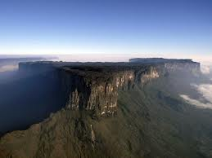
plateau (n.)
a large flat area, high above sea level
The Tibetan plateau is located in Asia.

Slide 6
dedicate (v.)
to give all of energy or time to do something
They dedicate their free time to knitting.

Slide 7
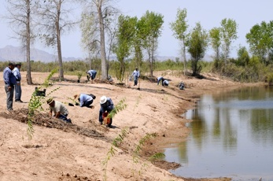
restoration (n.)
returning something to its good condition
Restoration work on forestation is now complete.

Slide 8
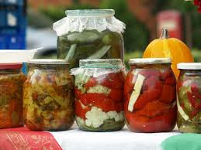
conserve (v.)
to protect something from damage or change
Some fruits are conserved in the glass jars.

Slide 9
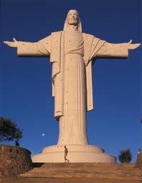
monument (n.)
a structure built to honor a special person or event
In the centre of a town stands the monument for
peace.

Slide 10
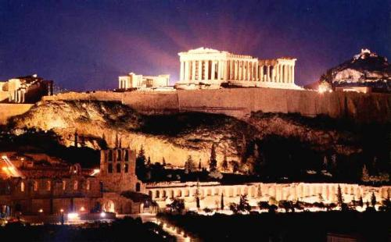
civilization (n.)
human society with its organization or culture
Greek civilization is very remarkable.

Slide 11
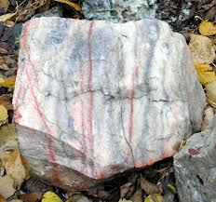
marble (n.)
hard rock can be polished to be smooth and shiny
The Parthenon is made of marble.

Slide 12
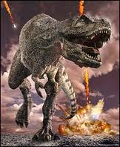
extinct (adj.)
not now existing
All types of dinosaurs became extinct.

Slide 13
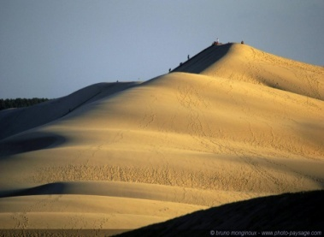
dune (n.)
a hill of sand near a beach or in a desert
Willandra Lake is full of sand dunes.

Slide 14
STRUCTURE

Slide 15
Passive Voice (Present Simple)
Form:
S
is
am
are
past participle
Many watches are made in Switzerland.
English is spoken in United States.
I am punished by the principal every day
Christmas cards are sent to friends and
relatives.

Slide 16
Passive Voice (Present Simple)
Changing the active voice into the passive voice
People protect the eagles in many countries.
The Dutch grow tulips in large numbers.
Millions of tourists visit the Acropolis.
The eagles
Tulips
are
are
protected
grown
The Acropolis
visited
is
in large numbers.
by millions of tourists.
in many countries.

Slide 17
READING TEXT

Slide 18
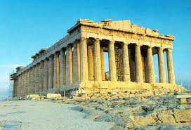
WORLD WONDERS
The Acropolis, Greece
The Acropolis in Athens is the most famous historical site in Greece. It is also known as 'the sacred rock' and it is home to one of the most important monuments of ancient Greek civilization, the Parthenon. The Parthenon is made of marble and is dedicated to the Greek goddess Athena. The Acropolis is visited by millions of tourists every year. Restoration work is done all the time to conserve and protect the site from acid rain and air pollution.

Slide 19
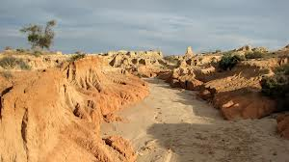
WORLD WONDERS
The Willandra Lakes Region, Australia
The Willandra Lakes Region in Australia is considered one of the most important archaeological areas in the world. 40,000 years ago, Aboriginal people lived there and it was a rich area with many freshwater lakes. 10,000 years ago the water dries up and today the region is just a dry lake bed full of sand dunes. Scientists have found bones of many extinct animals such as the Tasmanian tiger there.

Slide 20
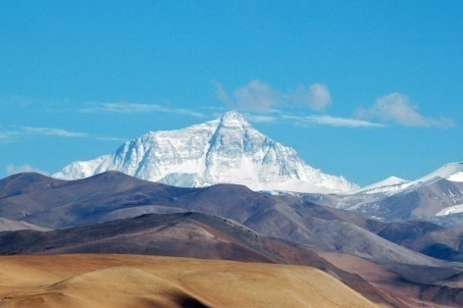
WORLD WONDERS
The Tibetan Plateau, Asia
All of the world's peaks that are over 7,000 meters high are located in the Tibetan Plateau and the Himalayas. This region is known as 'the roof of the world' and is the source of many of Asia's major rivers such as the Ganges and the Mekong. Unfortunately, the roof of the world is melting due to global warming.

Slide 21
LISTENING

Slide 22
TRUE OR FALSE
1. Find your own partners.
2. Get the TRUE and FALSE flags from a teacher.
3. Listen to the sound two times and the questions from the audio closely.
4. Take ten seconds to come up the correct answer.
5. Raise the TRUE flag if any statements you hear are correct and the FALSE flag for the incorrect statements.
6. The teams that can answer correctly will get one point.

Slide 23
The Acropolis is the most famous historical site in Egypt.
The Parthenon is made of the marbles.
People conserve and protect the Acropolis from acid rain.
The most important archaeological site in Australia is the Willandra Lakes Region.
There were a few freshwater lakes in the Willandra Lakes when the Aboriginals lived.
Nowadays, the Willandra Lakes Region is full of sand dunes.
The scientists found the fossils of the extinct dinosaur called Tasmanian.
The highest peak of the World is located in Asia Continent.
The Himalayas and the Tibetan Plateau are well known as the roof of the world.
The Ganges and the Mekong come from the Nile River.
Due to the global warming, the ice on the roof of the world is terribly melting.

Slide 24
TRUE
1 point

Slide 25
FALSE
0 point

Slide 26
READING

Slide 27
Spider Map
1. Make a group of three students.
2. Get some paper and pens from a teacher.
3. Summarize the passage about WORLD WONDERS by using a graphic organizer or Spider Map.
4. Take fifteen minutes to conclude, write down and color your paper.
5. Present your work to the class.

Slide 28
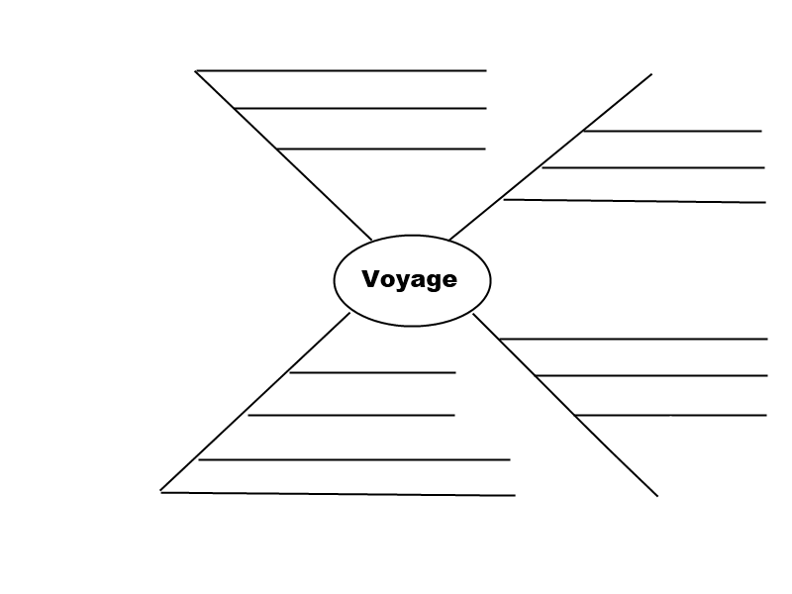
the roof of the world
7,000 meters high
The Acropolis
World Wonders
Willandra Lakes Region

Slide 29
SPEAKING

Slide 30
English Skit
1. Make a group of five students.
2. Choose one interesting historical place in your hometown.
3. Do the skit about its history and express your ideas or opinions about that place.
4. Take ten minutes to prepare your skit.
5. Present your skit in front of the class.

Slide 31
Situation: You and your friends want to visit some historical place in your hometown. You talk about its history and your opinions and invite your friends to go there.
A: Hey! C, D, E,. Today I want to visit _____ in
our province.
B: C, Do you know the history of that place?
C: Yes, _______ was built over 300 years ago. I think the villagers were strong in harmony in building that amazing place.
D: That’s right. I read about its history as well. They built it to be a center mind of the Buddhist.
E: Wow, it sounds interesting. Shall we go now?

Slide 32
WRITING

Slide 33
Asian Heritage Writing
1. Make a group of five students.
2. Get paper and some color pencils from a teacher
3. Write down a story about Borobudur in Indonesia with the words given, draw a picture and color it.
4. Take fifteen minutes to finish your group work.
5. Present Asian Heritage Writing in front of the class.

Slide 34
historical site square platforms monument locate restoration stones preserve Buddhist temple
the given words

