Slide 1
Unit: Relationship with Other People
Topic: Special Day
Pratomsuksa 5

Slide 2
Video
Vocabulary
Structure
Conversation
Activity 1
Activity 2

Slide 3
Let’s go to a birthday party!

Slide 4
1. What is the special day in the video?
2. Where do they have a birthday party?
3. What does Dylan’s mother give him for his birthday?

Slide 5
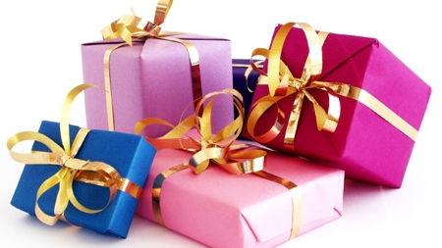
present
My mother gives me a birthday present.
(n.) something that you are given in a special occasion without asking for it

Slide 6
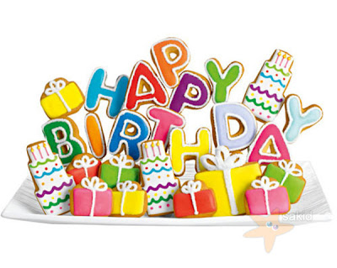
birthday
My birthday is on January 3rd 2000.
(n.) the day that is exactly a year or number of years after a person was born.

Slide 7
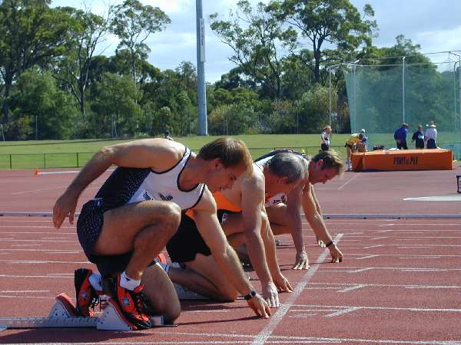
begin
(v.) to start to happen or to exist
The runners begin to run.

Slide 8
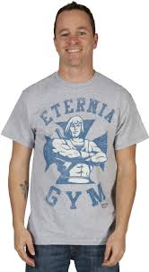
wear
(v.) have something on one’s body as clothing, decoration or protection.
He is wearing a gray T-shirt.

Slide 9
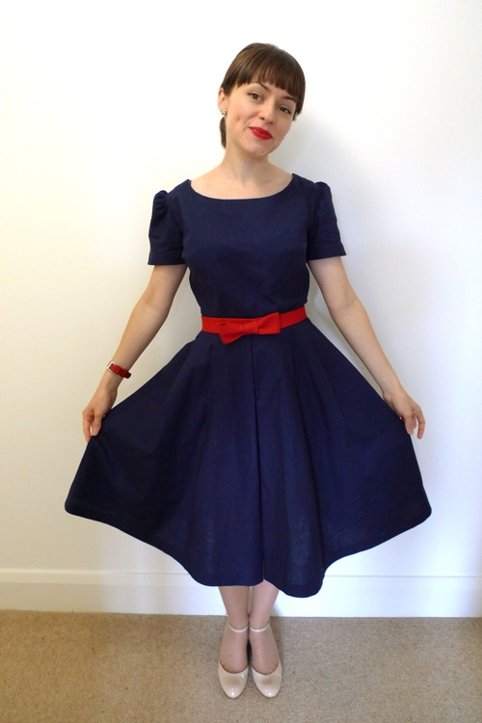
dress
She will wear a new dress to a party.
(n.) a piece of clothing for women or girls covering the top – half of a body and hang down over the legs.

Slide 10
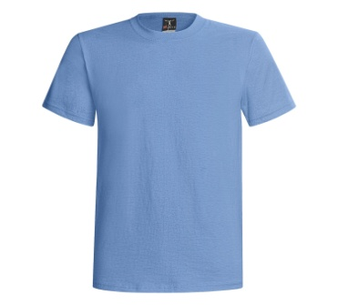
T-shirt
He usually wears this blue T-shirt.
(n.) simple piece of clothing with short sleeves and no collar covering the top part of a body.

Slide 11
Future Simple Tense
Form:
S
will/shall
V
O
He will go to London next month.
We will (shall) read books tonight.
I will wear my new dress to a party.
I shall wear my new dress to a party.
shall can be used instead of will for only “I” and “We”.

Slide 12
Usage:
To talk about things that will happen
in the future
She will wear a pink dress tonight.
He will go to the cinema tomorrow.
My friends will visit the zoo next week.
We shall study English next Friday.
Adverbs of time may include tonight, tomorrow, next week or next Friday to indicate the future time.

Slide 13
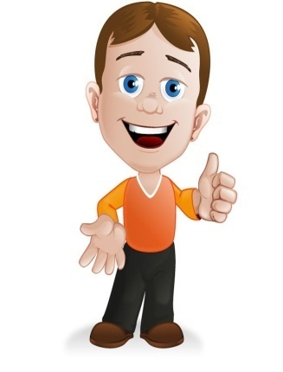
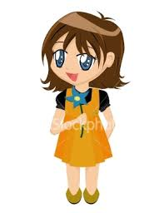
Will you go to Sue’s birthday party today?
Yes, of course. I have a present for her.
Me, too.
What time does it begin?
At 5 in the afternoon.

Slide 14
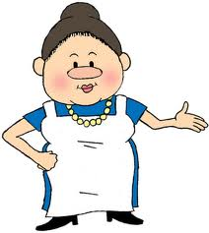
Mummy, what should I wear to the party?
Oh! Dear. I like your pink T-shirt with the red skirt.
They are old!
How about your new blue dress?
Oh! That’s better. I like it.

Slide 15
1. Will David go to Sue’s birthday party?
2. Do David and Mary have the presents for Sue?
3. What will Mary finally wear to Sue’s birthday party?

Slide 16
ACTIVITY 1 Correct or Incorrect Game
1. Make a group of three students.
2. Get the Correct and Incorrect flags from a teacher.
3. Listen to the whole conversation and the questions from the audio carefully.
4. Take ten seconds to come up the correct answer.
5. Raise the Correct Flag if any statements you hear are correct and the Incorrect Flag for the incorrect statements
6. The teams that can answer correctly will get one point.

Slide 17
David will go to Sue’s birthday party. 
David doesn’t have a present for Sue. 
Mary has a present for Sue. 
The party begins at 8 in the afternoon. 

Slide 18
Mary likes a pink T-shirt. 
Mary’s mother likes the red skirt. 
Mary doesn’t like a blue dress. 
Mary wears a blue dress to the party. 

Slide 19
ACTIVITY 2 Role Play
1. Make a group of three students.
2. Do the role play about the clothes you will wear to your friend’s birthday party.
3. Take ten minutes to create the conversation
and prepare the role play.
4. Come to present the role play
in front of class.

Slide 20
Situation: Jennie, Alice and Tom will go to birthday party. They are talking about clothes that they will wear.
Jennie: What will you wear to the birthday party?
Alice: I will wear ______ and ______ .
Jennie: Those are beautiful.
Alice: Tom, what will you wear?
Tom: I will wear ______ , ______ and ______ .
Tom: And what will you wear, Jennie?
Jennie: I will wear ______ with ______ .

