Slide 1
Theme
Jigsaw
Video
KWL
Vocabulary
Structure
New Year Celebrations around the World

Slide 2
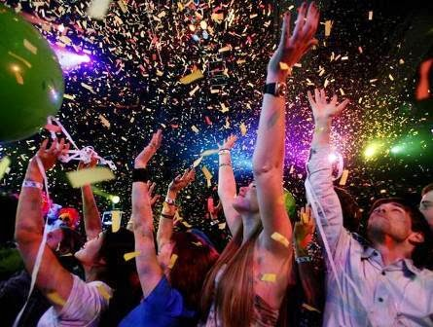

Slide 3
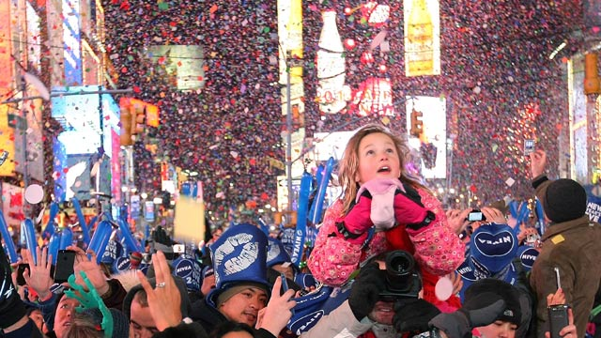

Slide 4
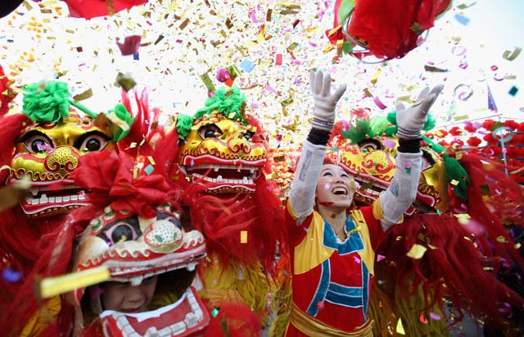

Slide 5
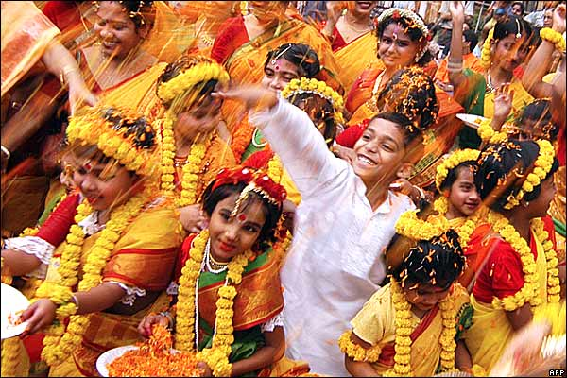

Slide 6
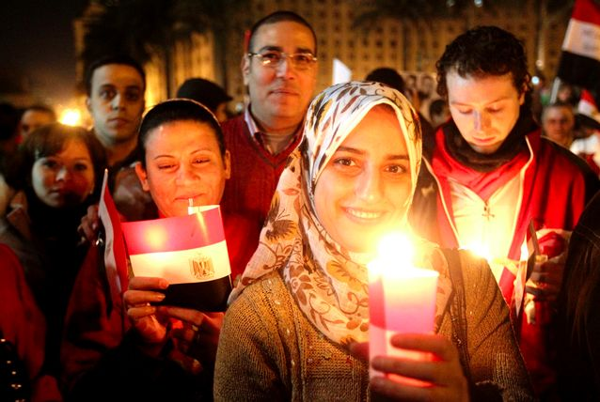

Slide 7
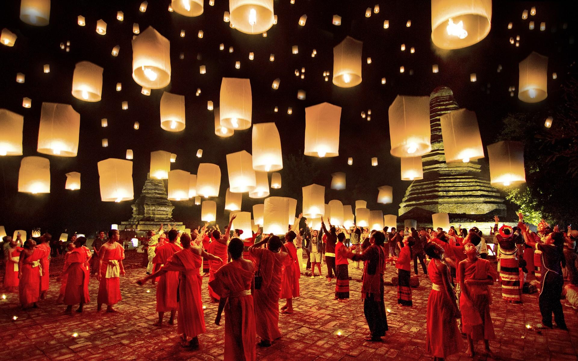

Slide 8
Look at the photos: what is a theme?

Slide 9
Video

Slide 10
Questions
What is the video mainly about?
How many countries are mentioned in the video?
When was New Year celebration in Scotland held?

Slide 11
VOCABULARY

Slide 12
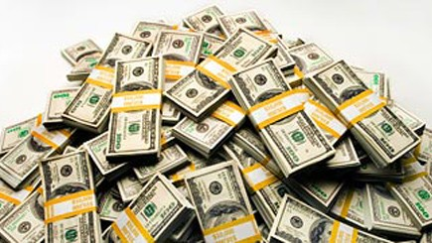
wealth (noun)
The celebrations are intended to bring luck, health, wealth and happiness
a large amount of money or
Valuable possessions that someone has

Slide 13
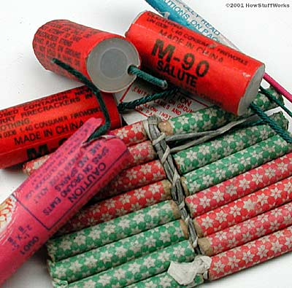
firecracker (noun)
They decorate their houses with plastic firecrackers in order to ward off any bad luck.
a firework that makes a loud noise when it explodes

Slide 14
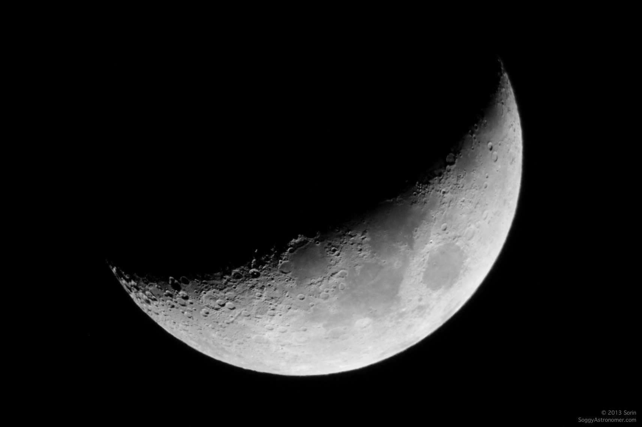
crescent (adjective)
New crescent moon must be seen before the official announcement is made.
waxing, as the moon approaching its first quarter phase

Slide 15
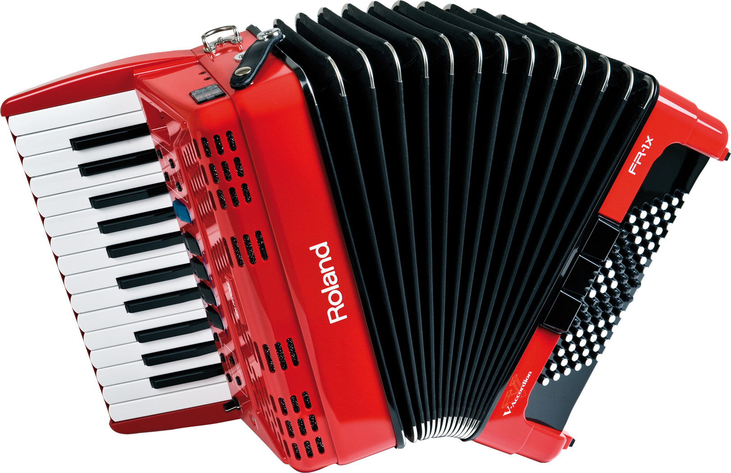
accordion (noun)
The sweets are surrounded by colored paper fashioned like an accordion.
a box shaped
Musical instrument consisting of a folded central part with a keyword

Slide 16
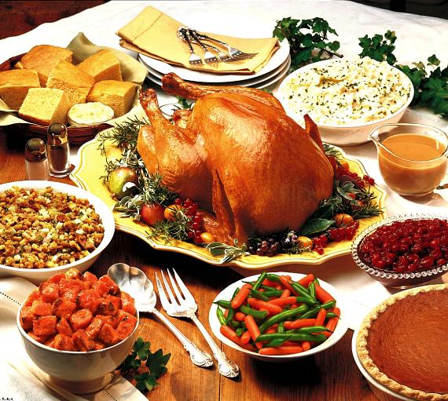
feast (verb)
In celebration of Rama's victory, people feasted and lit oil lamps in their homes.
to give a feast for; entertain or feed sumptuously

Slide 17
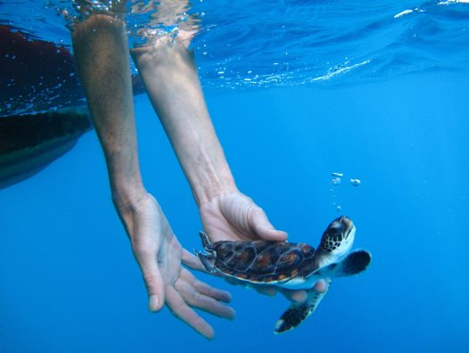
release (verb)
One ancient good luck custom in Thailand is to release birds from their cages and carry fish to the river
to give freedom or free movement to someone or something

Slide 18
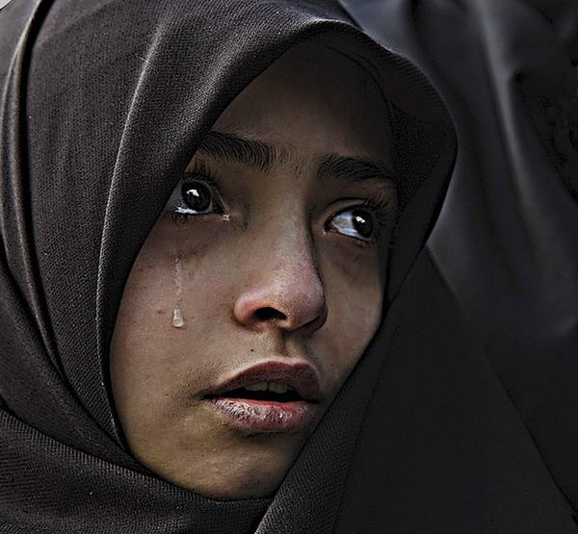
sorrow (noun)
people count along with the 108 peelings, which represent the hardships and sorrows of the past year.
a cause of a feeling of
great sadness

Slide 19
STURCTURE

Slide 20
Present Simple Tense (Passive)
Form:
S
is
am
are
past participle
Yuan Tan is celebrated by Chinese people all over the world.
The sighting is carried out at the Muhammed Ali mosque.
Cards and gifts are exchanged on Indian New Year.

Slide 21
While-act 1: KWL Reading
Directions:
Work in a group of five.
Take a piece of paper and a marker, make a KWL table and complete the K and W columns.
Take 15 minutes to read a text and complete the L-column with what you read.
Present your KWL table to your classmates.

Slide 22
While-act 1: KWL Reading
KWL Table:
New Year Celebrations around the World
K: Know | W: Want | L:Learn
... | …. | …

Slide 23
Post-act 1: JIGSAW Reading
Directions:
Work in a group of five-Home Group.
Take a reading text and spend 5 minutes reading and 10 minutes to discuss in a group.
Count 1- 5 in Home Group, walk to your Expert Group and spend 10 minutes for discussion.
Go back to your Home Group, create and present a Mind Mapping of New Year Celebrations.

Slide 24
Post-act 1: JIGSAW Reading
Directions:
JAPAN
INDIA
USA
NEW YEAR Celebrations
EGYPT
THAI
LAND

