Slide 1
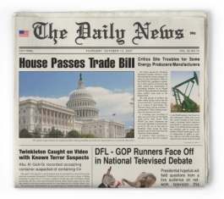
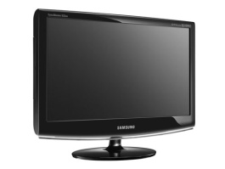
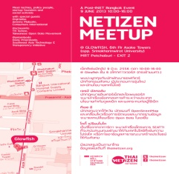
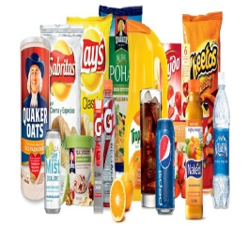
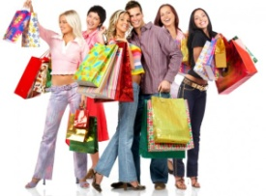
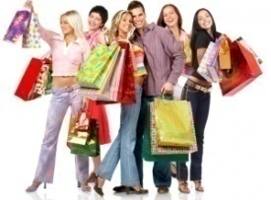
a newspaper
a television
a classified
a brochure
a flyer
an internet
a product
a customer
PRODUCT ADVERTISEMENT

Slide 2
PRODUCT ADVERTISEMENT
Video
Vocabulary
Structure
Reading
While-Act
Post-Act

Slide 3
PRODUCT ADVERTISEMENT

Slide 4
Questions
What is the video mainly about?
What is the advertisement used for?
How is the advertisement important for customers?
PRODUCT ADVERTISEMENT

Slide 5
VOCABULARY

Slide 6
There are so many that you might not even notice them.
to see or become consciousness of something or someone
notice (verb)

Slide 7
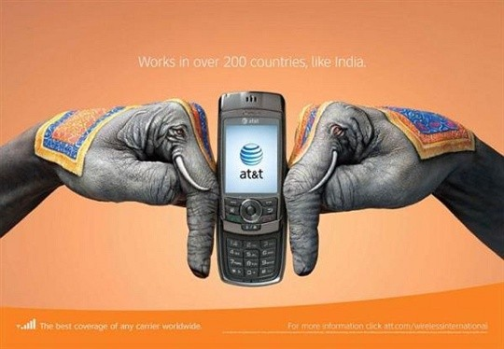
To advertise means to call something to the attention of the public.
to make something known generally
or in public, especially in order to sell it
advertise (verb)

Slide 8
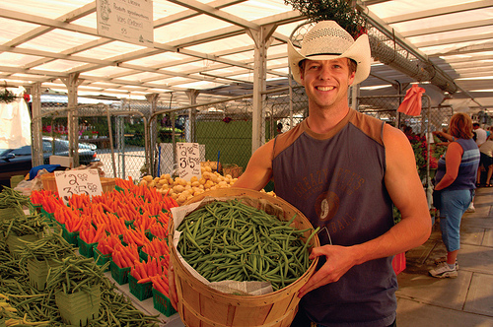
Street vendors advertise by calling out loudly: “Bananas – 10 for 2 dollars!”
someone who is selling something
vendor (noun)

Slide 9
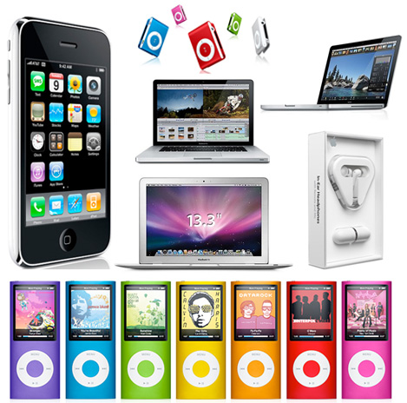
Vendors prefer to advertise their products on posters that can be found everywhere.
something that is made to be sold, or produced by an industrial process
product (noun)

Slide 10
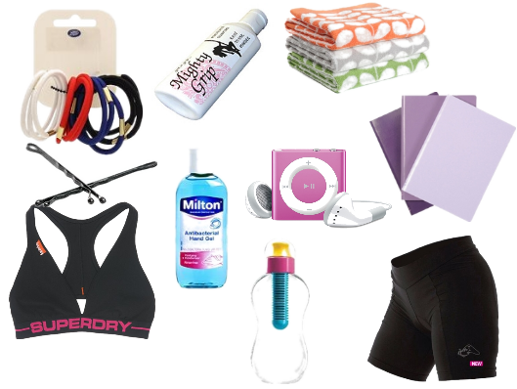
Advertisements are necessary –that’s what a lot of companies have experienced.
needed in order to achieve a particular result
necessary (adjective)

Slide 11
A good logo is unique and not easily confused with logos of other companies.
being the only existing one of its
type or, more general, unusual, or
special in some way
unique (adjective)

Slide 12
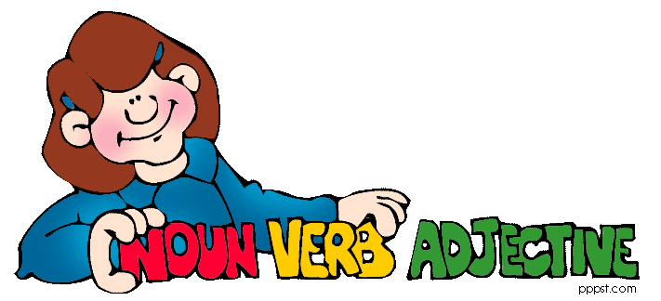
STURCTURE

Slide 13
Use the Superlative to compare one member of a group to the whole group.
1. Add –est after one-syllable adjectives
long
longest
nice
nicest
hot
hottest
new
newest
2. Change y into i before adding –est
lazy
laziest
happy
happiest
sexy
sexiest
busy
busiest
Superlative Adjective

Slide 14
3. Add most- before adjectives that are over two syllables
beautiful
most
beautiful
punctual
most
punctual
4. Some adjectives are changed irregularly
good
best
many
most
bad
worst
far
furthest
little
least
Superlative Adjective

Slide 15
Examples
The mobile phone is the best device of all.
Joanna is the most beautiful girl in this room.
Kennedy is the funniest boy of all.
Frank and I were the fastest car racers.
Superlative Adjective

Slide 16
READING TEXT

Slide 17
Questions
Where are the product advertisements often seen?
How do the street vendors advertise their products?
What is the important part of advertisement and selling products?
PRODUCT ADVERTISEMENT

Slide 18
Directions:
Work in a group of three.
Take five minutes to read the reading text.
Take a piece of paper and a marker, and then write a conclusion of a text using a Brainstorming web.
Present the conclusion web to your classmates.
Act 1: Brainstorming Web

Slide 19
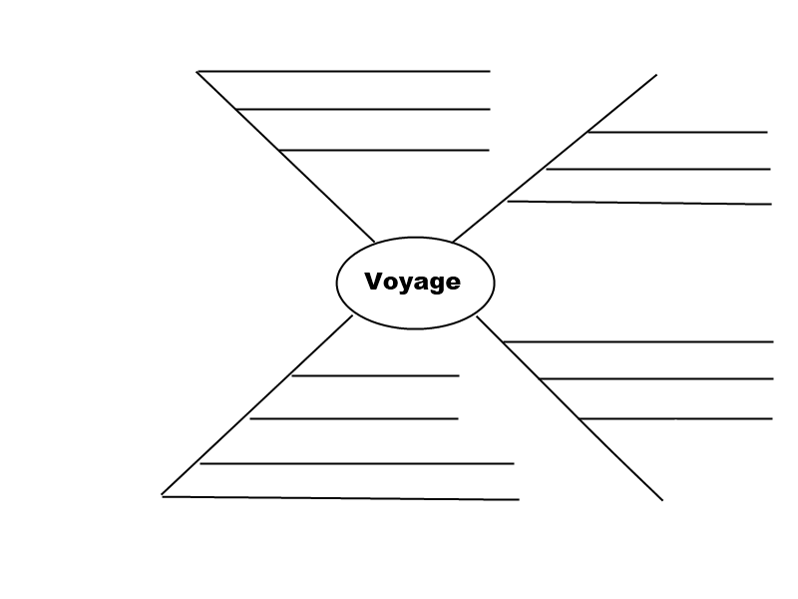
Product Advertisement
Example:
Act 1: Brainstorming Web

Slide 20
Directions:
Work in a group of five.
Take a piece of paper, some markers and crayons to your own group.
Create a product advertisement from the product given and write at least three sentences about goods.
Present it to your classmates and stick it on a wall.
Walk around a room seeing and posting a star on your most satisfying product advertisement
Act 2: Product Walk

Slide 21
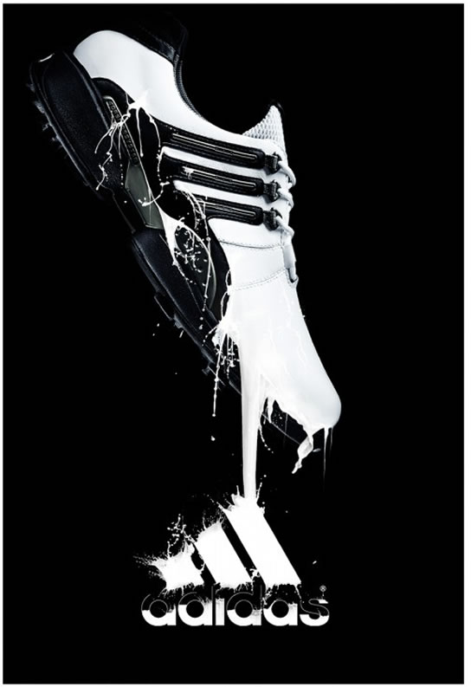
Adidas is all in
This is the most comfortable shoes for all activities.
It costs 10 dollars.
(May 10-June11)
Buy it online:
www. Adidas.co.us
With a special gift,
Free CANON Camera
Example:
Act 2: Product Walk

